Slide 1
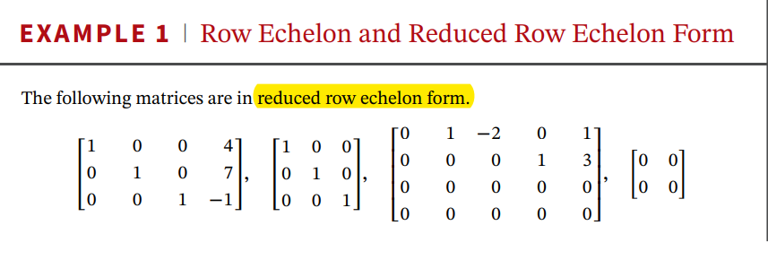


Slide 2

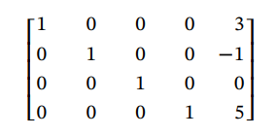

Slide 3


Slide 4


Slide 5
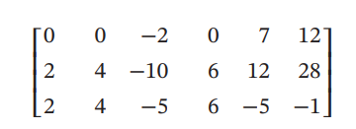
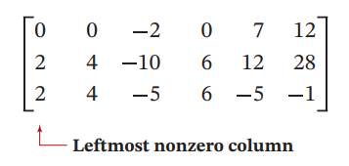
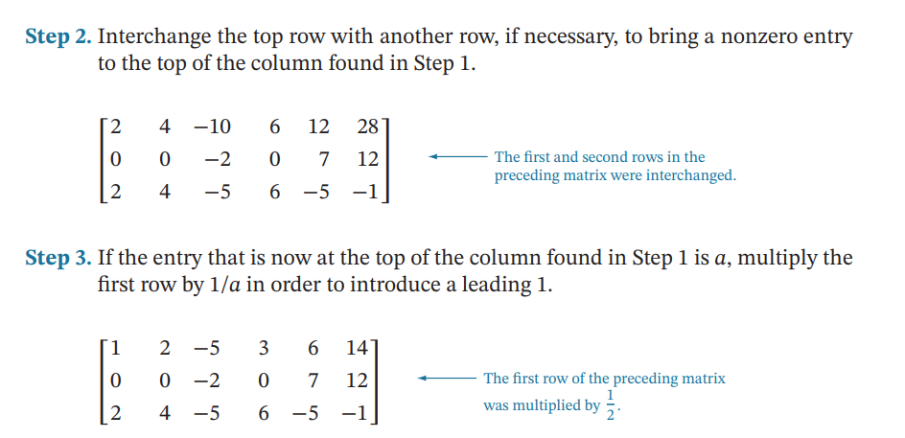

Slide 6



Slide 7
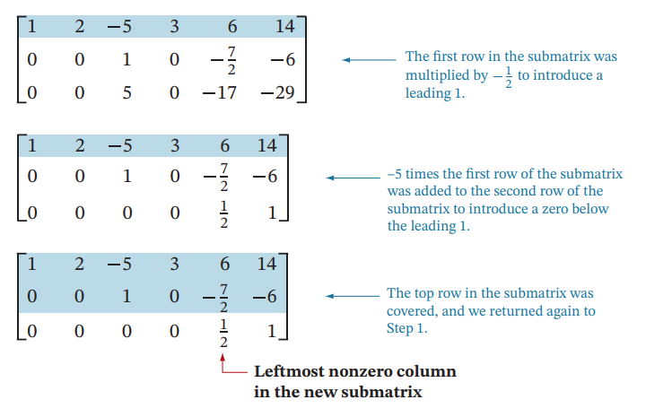


Slide 8
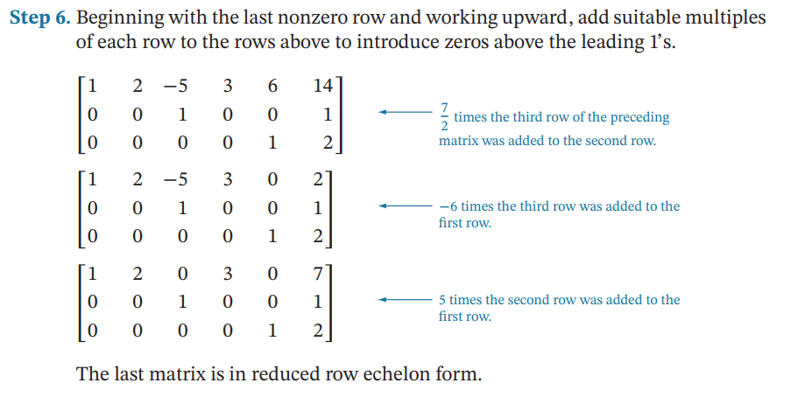

Slide 9


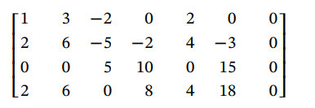
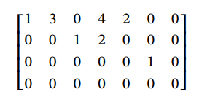

(never inconsistent)
There are only two possibilities for its solutions:
• The system has only the trivial solution. ($x_{1}$ = 0, $x_{2}$ = 0,..., $x_{n}$ = 0)
• The system has infinitely many solutions in addition to the trivial solution.

Slide 10
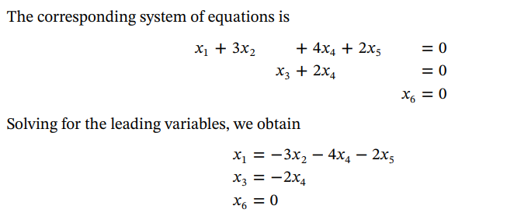


Slide 11

For Non-Homogeneous system: If a non-homogeneous system with more unknowns than equations is consistent, then it has infinitely many solutions.

Slide 12

